Slide 1
MyLife
Medical journal.

Slide 2

Problem
Barriers and miscommunications
In-house or home treatment

Slide 3
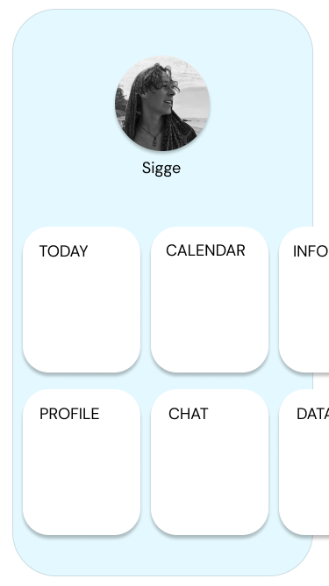
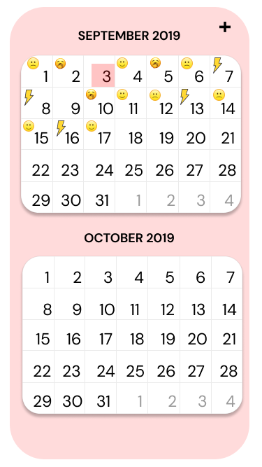
Solution
MyLife’s calendar function chronicles patient issues.
Emojis are used as feeling and symptoms indicators.

Slide 4
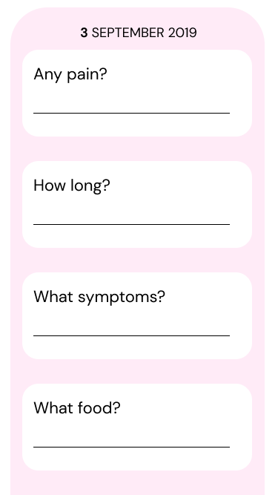

Users
Symptoms backed with evidentiary support.
The evolution is documented on the calendar.

Slide 5

Scalability
Eliminating the language barrier
Emojis
Patient controlled data

Slide 6

Thank you for your time!

